Slide 1
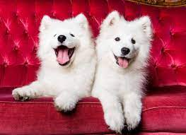
Psychology of
dogs

Slide 2
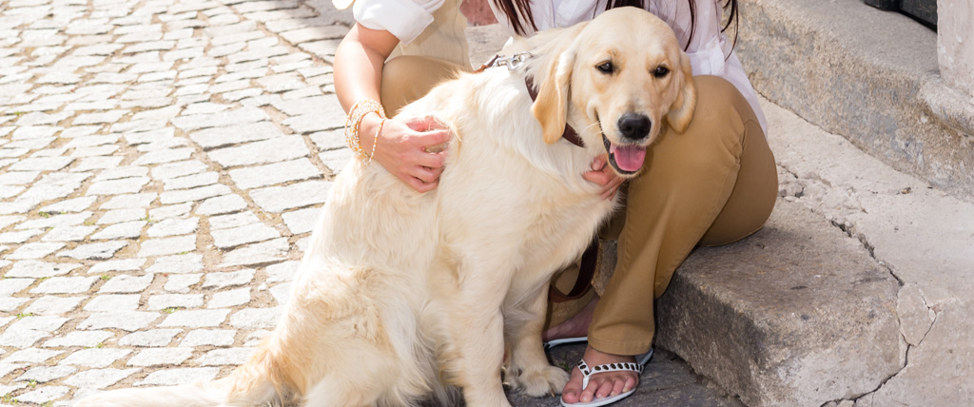
#1
LEANING
Whenever your dog leans on you and puts their whole-body weight on you. That's actually their way of hugging you and telling you that they love you.

Slide 3
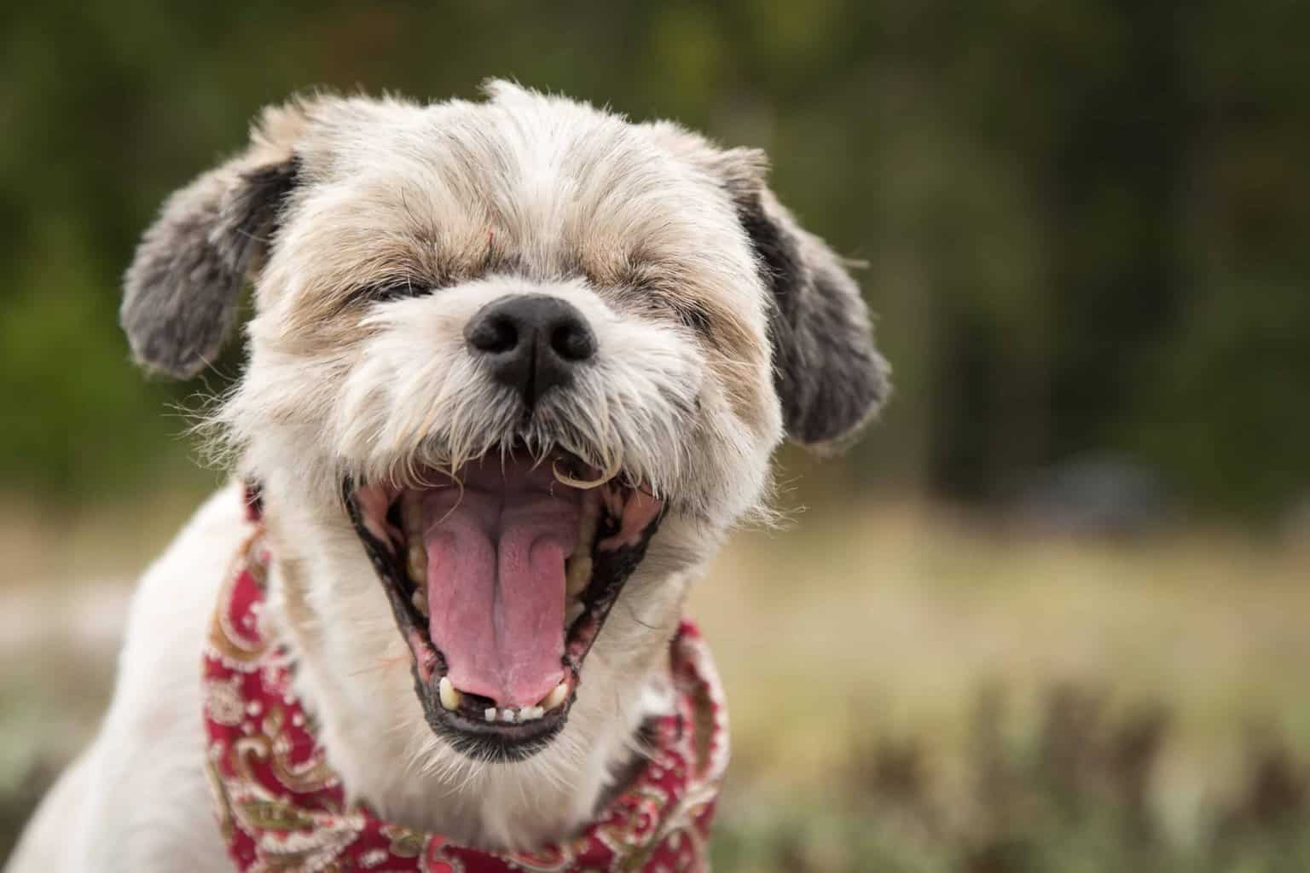
#2
Sneezing
Dogs will actually sneeze when they are playing fighting to show that they are just playing around and they don't actually want to hurt U

Slide 4
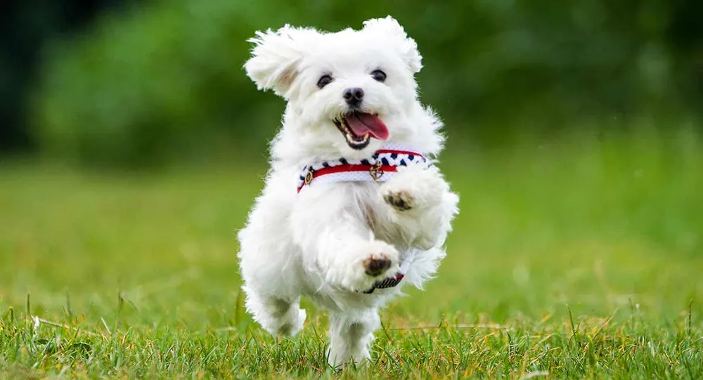
#3
Zoomies
Zoomies are short bursts of energy your dog just can't seem to control. Researchers have found only happy healthy dogs get the zoomies. So, if your dog is doing the zoomies, then you are doing everything right.

Slide 5
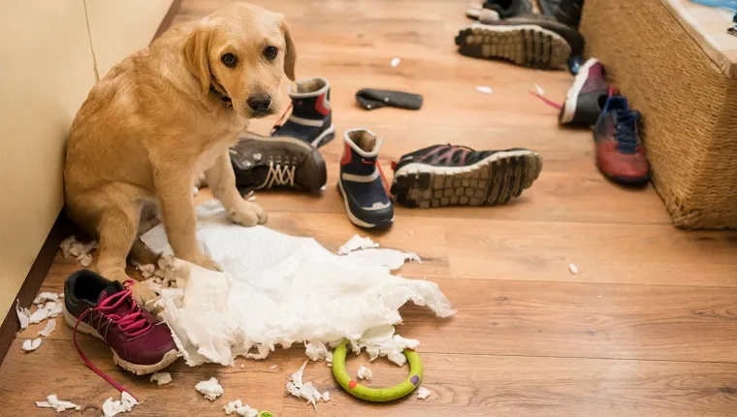
#4
Guilt Trips
You may feel guilty when you catch your dog quietly, staring at you before you leave the house. But fear not, their calmness is a sign that they trust you and know that you're coming back.

Slide 6
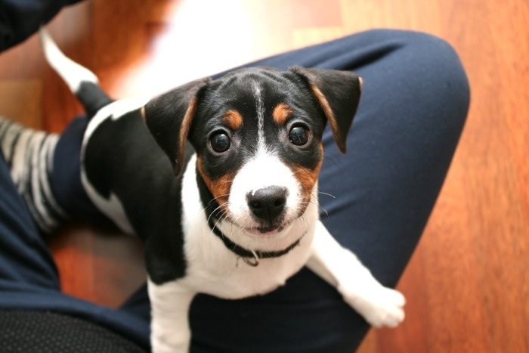
#5
Eye Contact
Whenever your dog looks deeply into your eyes, right before they poop, it means they feel vulnerable and they trust you to keep an eye out for them.

Slide 7
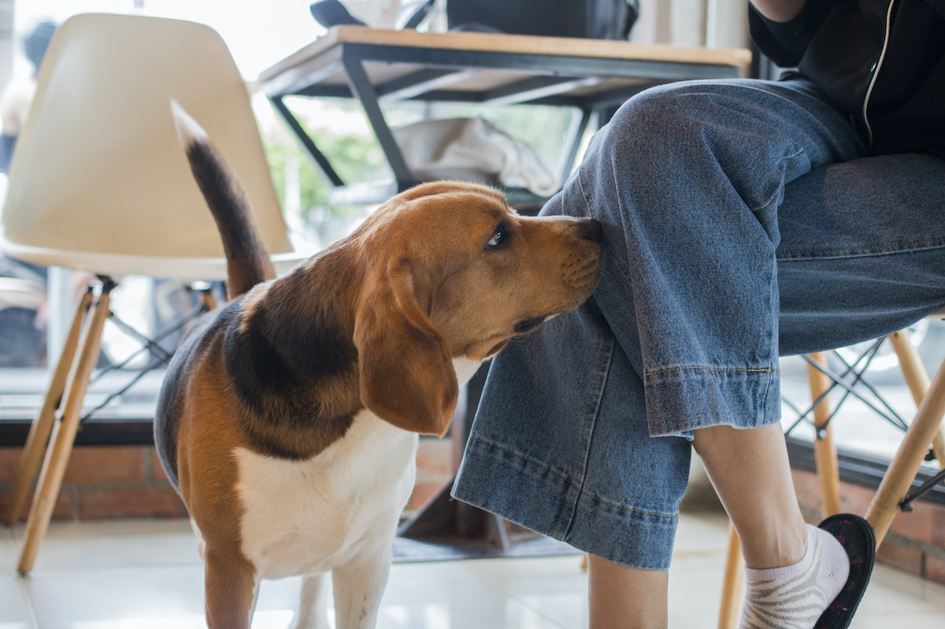
#6
Smelling Your Crotch
If your dog is smelling your crotch, this is your dog's way of checking your health and mood. Dogs use a sense of smell to read details and their surroundings. So, your dog is just checking to see if you're okay.

Slide 8
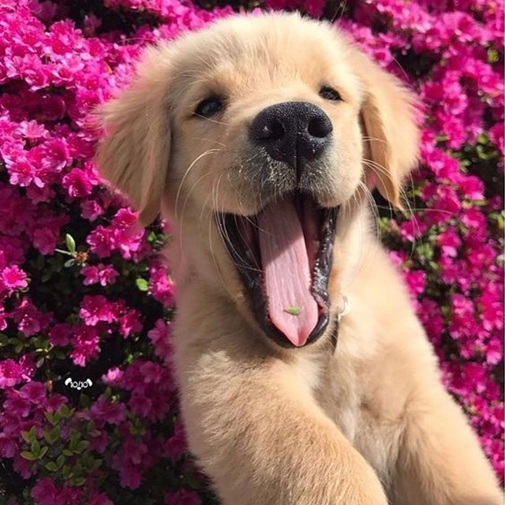
#7
Yawn
Yawn is not quite the same as a human yawn. Dogs yawn in order to reduce stress and reduce anxiety, which helps them calm down and remain comfortable.

Slide 9
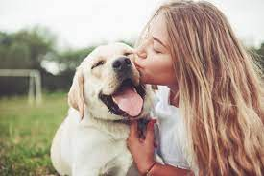
#8
Dogs Have Best Friends
Researchers have found that dogs have a best friend. Dogs love humans and other animals too, but any dog owner can attest that they have one true best friend. They're loyal to one and that's the dog owner.

Slide 10
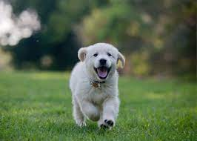
#9
Excited When You Come Home
Does your dog do a little dance or get the case of the zoomies when you come home? Researchers find that a happy, noisy, tail wagging greeting is one of the surest signs that you and your dog are connected.

Slide 11
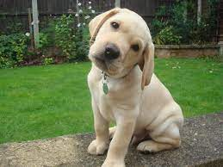
#10
Tilting Their Head
When your dog tilts their head while looking at you, this is because they're trying to read your body language and they are analysing your tone of voice.

Slide 12
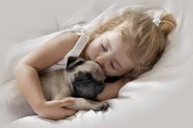
#11
Sleeping With You
Researchers find that if your dog chooses to sleep next to you, it means they trust you like no one else. Scientists have found that sleeping with your dog helps you sleep better throughout the night and decreases overall stress.

Slide 13
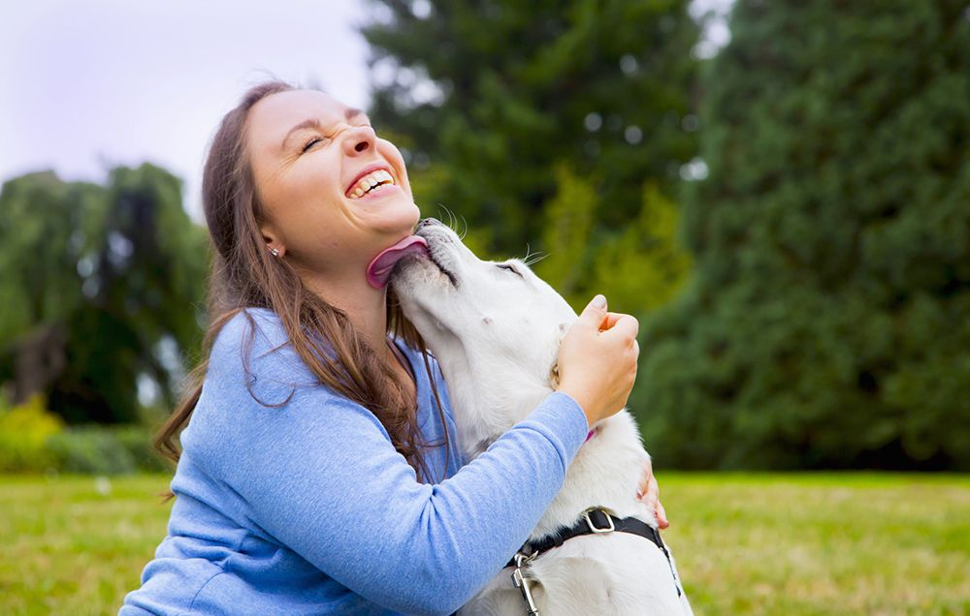
#12
Licking When You're Hurt
If you get a cut and your dog tries licking it, this is because your dog has antibacterial compounds in their saliva. So, when they try to lick your cut, this is because they're trying to help you heal faster.

Slide 14
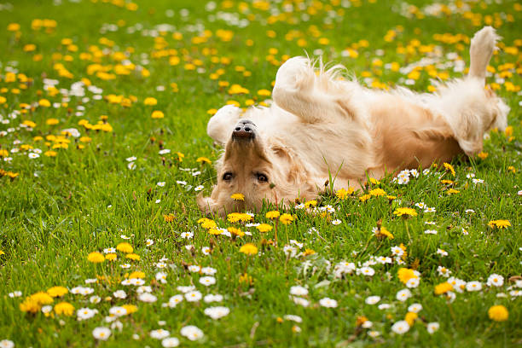
#13
Roll In the Grass
Dogs roll in the grass for the same reason children do it. It's soft, smells good and is a fun way to release energy.

Slide 15
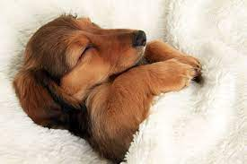
#14
Lots Of Sleep
A healthy, happy adult dogs usually sleep for up to 16 hours a day. If your dog is not sleeping that much, this could be a sign of stress.

Slide 16
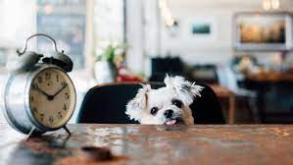
#15
Sense Of Time
Researchers have proven that dogs know the difference between an hour and five hours. If conditioned to, they can predict future events, such as regular walk signs and feeding schedules.

Slide 17
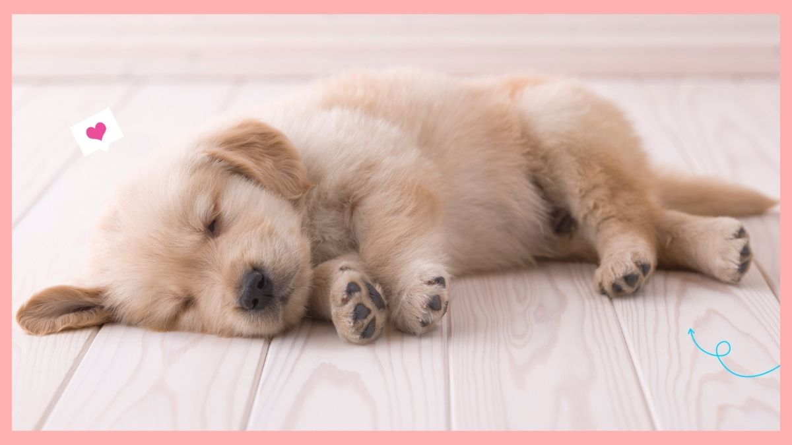
#16 Sleeping
Researchers have found all dogs dream, but puppies and senior dogs dream more frequently than adult dogs

Slide 18
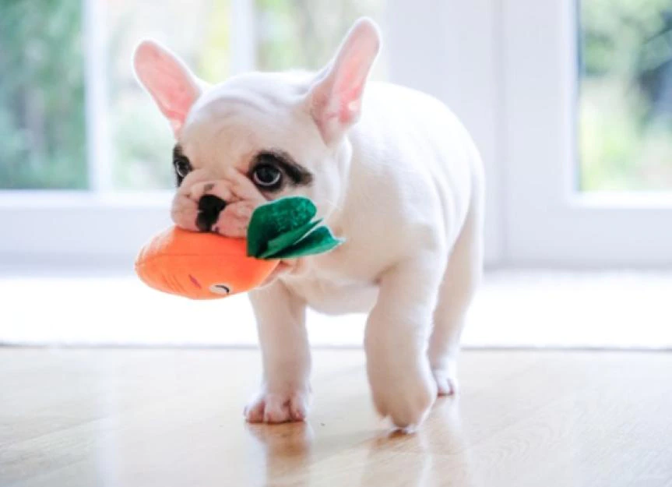
#17
Carrying Food, Treats, Toys
If your dog has a habit of carrying the food from one location to another, don't worry. This is common behaviour. Dogs do this as a way to protect their valued resources from being stolen.

Slide 19
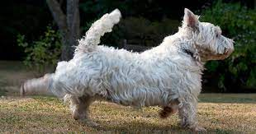
#18
Kicking Backwards
If your dog kicks backwards, after going to the bathroom, it's not to cover it up. It's done to mark their territory, using the scent glands in their feet.

Slide 20
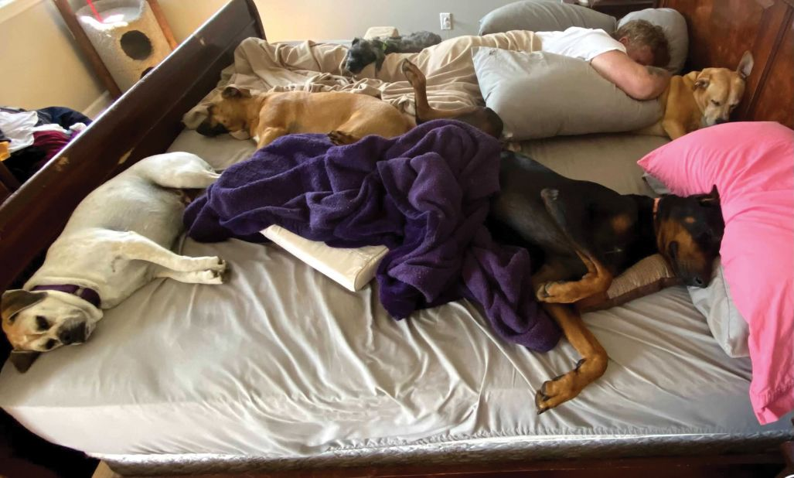
#19
Sleeping On Your Clothes
If your dog sleeps on your clothes, it means they love you. Your clothes have your scent on them and they just want to get closer to you.

Slide 21
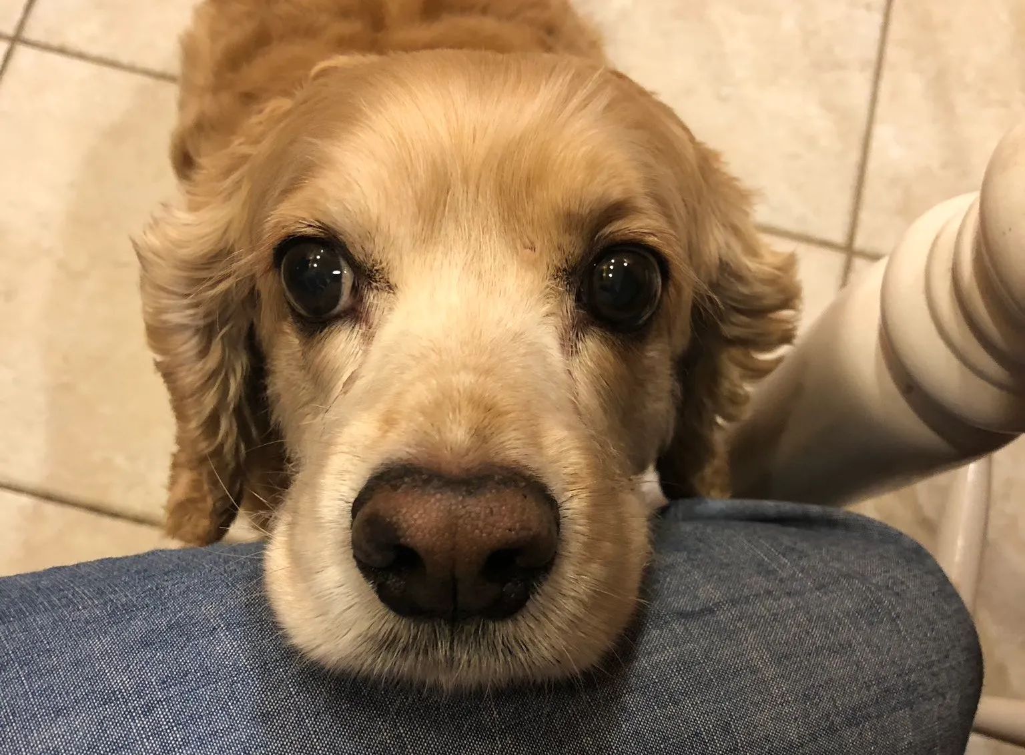
#20
Soft Eyes
When a dog is happy, their eyes will be a normal, soft shape. Their gaze will be relaxed and gentle and they will blink often.

Slide 22
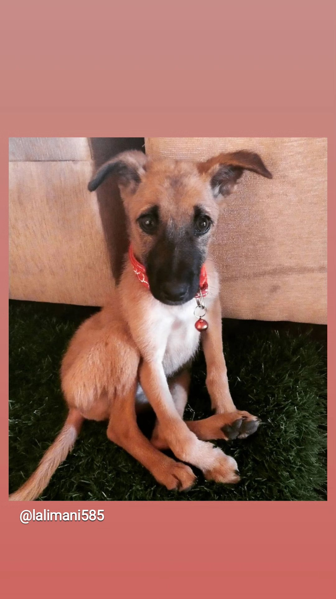
Thank you

